Slide 1
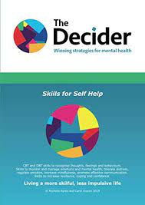
Improving Our School 2023-24
Working with DEPs to understand high quality learning and teaching using John Hattie visible learning approach
VR focus at second level
Embedding Voice 21 Oracy across all stages
Staff trained in Explicitly Teaching Writing approach
PEDAGOGY
USE OF VR TO RAISE ATTAINMENT IN WRITING
ORAL LANGUAGE INTERVENTIONS
CLOSING THE GAP IN WRITING
Shared Vision, Values, Aims
Child at the centre
TARGETING ATTAINMENT GAPS IN NUMERACY
CLUSTER STEM PROJECT
UNCRC GOLD AWARD
CLUSTER HWB
Using Numicon Big Ideas and Breaking Barriers
Effective Learning and Teaching & Skill development and progression across all levels
Progression from silver to GOLD
Shared language and strategies to improve resilience, coping and confidence

